Slide 1


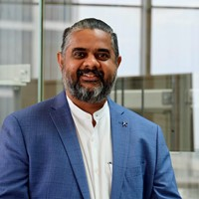


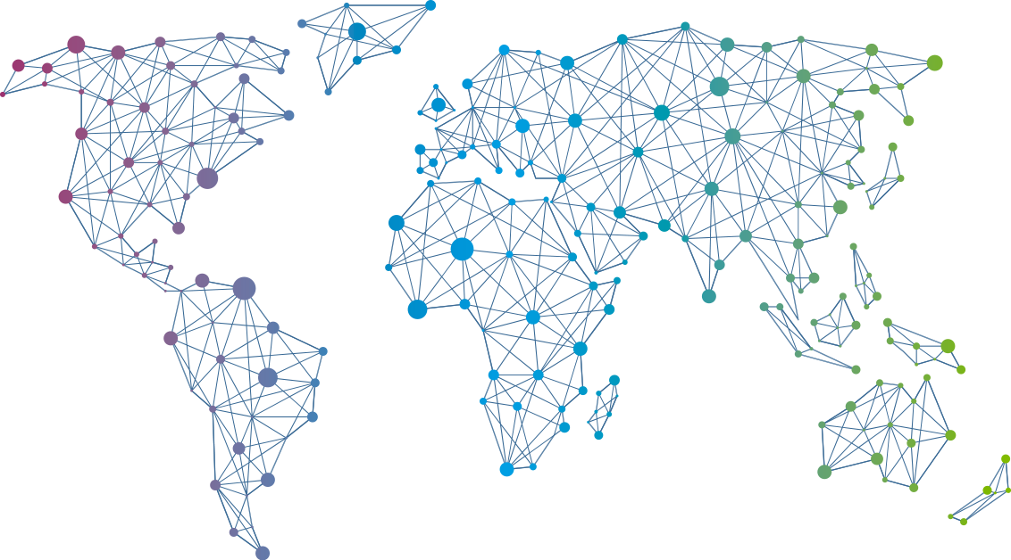

Speaker
Sriram Bhargav Madhav
Automation to Hyper-Automation Powered by AI and ML
Sriram Bhargav Madhav
Sriram Bhargav Madhav
September 16th & 17th
^{Online Event}
Powered By
International Conference

